Slide 1
MONITORING ANALYST TEST
Cloud Walk .Inc
05/25/2024

Slide 2

ABOUT ME
GENERAL INFORMATION
Cassiano josé Sobierai
01.
CurrentLY living IN
farroupilha, brazil
02.
CURRENTLY WORKING AT JOST BRAZIL AS
A Jr Data intelligence analyst
03.
GRADUATING Systems Analysis and Development at IFRS
04.

Slide 3
TABLE OF CONTENTS
01.
02.
03.
TEST 1: THE PROBLEM
TEST 1: THE process of analysis
04.
05.
06.
TEST 2: CREATING THE SYSTEM
TEST 2: VISUALIZING THE SYSTEM
conclusion
TEST 2: THE monitoring system
An introduction to the first part of the test
Getting insights of the avaliable data
An introduction to the second part of the test
The development process of the system
Showing the results of the system
Lessons learned

Slide 4
TEST 1: THE PROBLEM
THE DATASETS
Column | Type of data | Ex:
Time | String | 01h
today | Integer | 9
Yesterday | Integer | 11
same_day_last_week | Integer | 11
avg_last_week | Float | 6.42
avg_last_month | Float | 4.85
Identify any anomalous behavior in a sales data.
The test provided two similar datasets, about transactions per hour. Both have 24 lines from 00h to 23h.

Slide 5
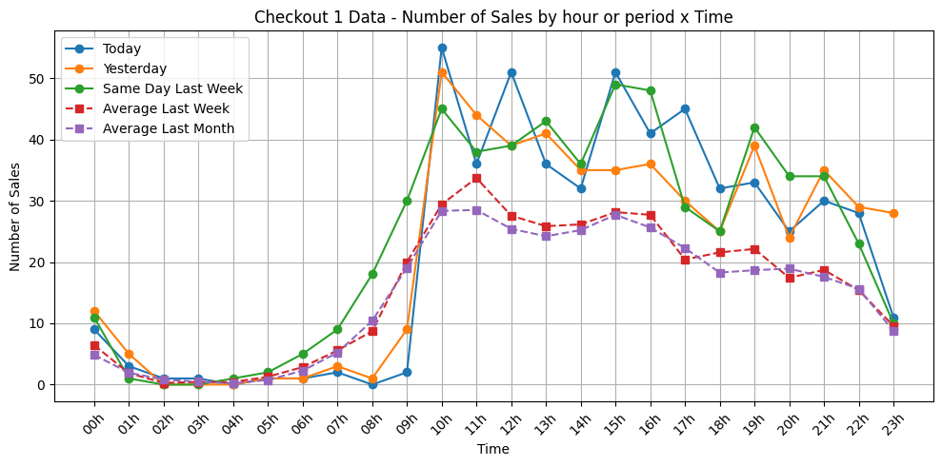

TEST 1: THE PROCESS OF ANALYSIS
CHECKOUT 1 DATA
All daily data shows
spikes in sales,
if compared to the averages.
Yesterday data does not finish the day like all the other data.
Averages have similar trends.
Overview of the data

Slide 6
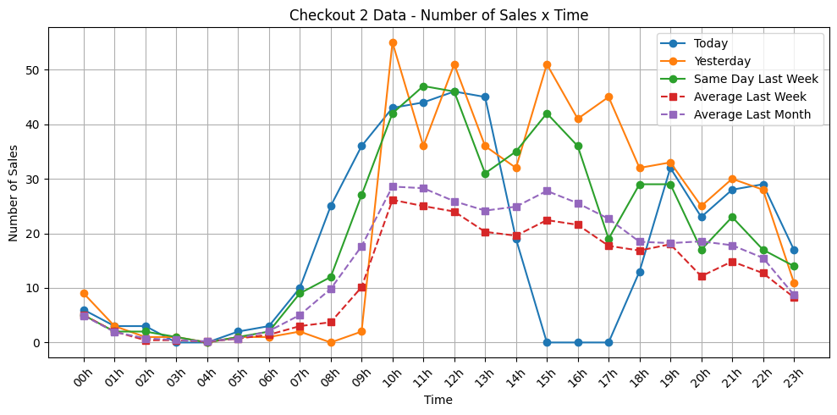
TEST 1: THE PROCESS OF ANALYSIS
CHECKOUT 2 DATA
Yesterday and Same_day_last_week data shows spikes in sales,
if compared to the averages.
Today data have zero sales between 15h and 17h
Avarages have similar trends.
Overview of the data

Slide 7
about the required sql query
The limited dataset precludes robusts queries, but here is an
example where SQL could be applicable.
SELECT
time,
today,
AVG(avg_last_week) AS avg_sales,
STDDEV(avg_last_week) AS sales_std_dev,
CASE
WHEN today > AVG(avg_last_week) + 2 * STDDEV(avg_last_week) THEN 'High Anomaly'
WHEN today < AVG(avg_last_week) - 2 * STDDEV(avg_last_week) THEN 'Low Anomaly'
ELSE 'Normal'
END AS anomaly_status
FROM ['Table Name']
GROUP BY time, today;
IDENTIFY POTENCIAL ANOMALIES

Slide 8
TEST 1: THE PROCESS OF ANALYSIS
The dataset given is too small to perform a robust analysis. Limited data points can lead to unreliable conclusions and missed anomalies.
problem
Communicate the issue to the team and stakeholders. Request more extensive data to conduct a thorough and accurate analysis.
solution

Slide 9
TEST 2: THE monitoring system
SEND ALERTS
LIVE DASHBOARD
DETECT ANOMALIES
ENDPOINT
Receive transactions at any time
Notify relevant teams when transactions are above normal
Provide a real-time view of some transaction statuses.
Identify unusual transaction points using predefined criteria

Slide 10
TEST 2: CREATING THE SYSTEM
ACTION PLAN TO DEVELOPMENT
01.
FLASK ENVIRONMENT
02.
DASHBOARD FRONT-END WITH PLOTLY
03.
TRANSACTIONS ENDPOINT
04.
TRENDS ALERTS IN TEAMS
05.
DETECT ANOMALIES

Slide 11
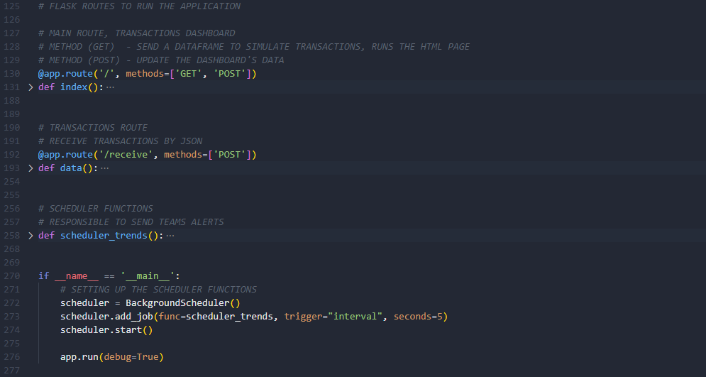
TEST 2: CREATING THE SYSTEM
01.
FLASK ENVIRONMENT

Slide 12
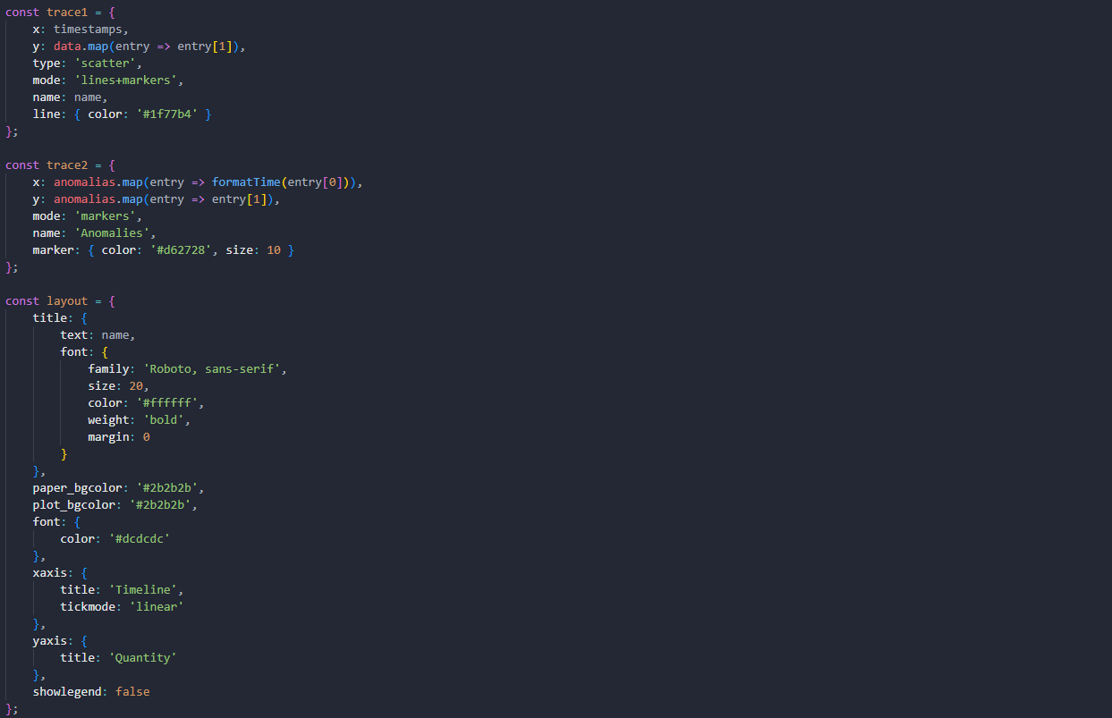

TEST 2: CREATING THE SYSTEM
02.
DASHBOARD FRONT-END WITH PLOTLY

Slide 13
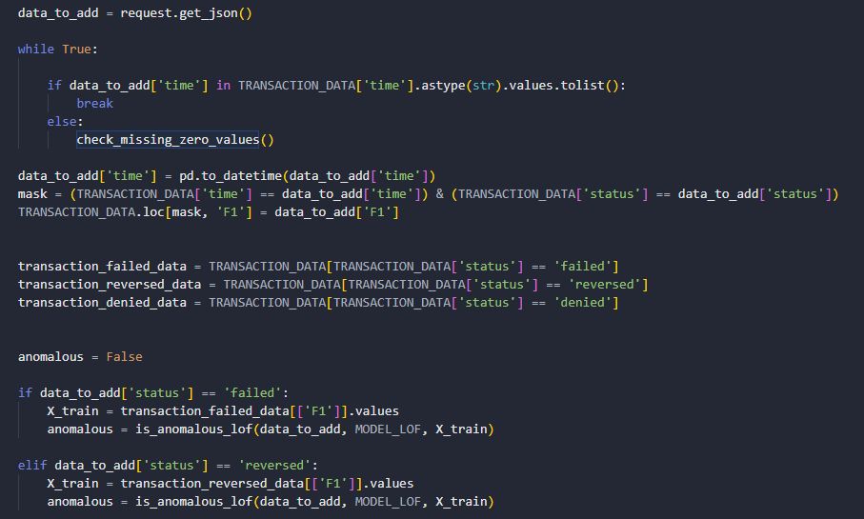
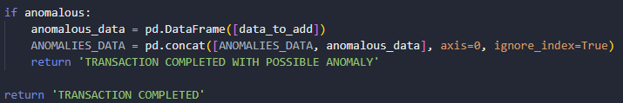
TEST 2: CREATING THE SYSTEM
01.
TRANSACTIONS ENDPOINT

Slide 14
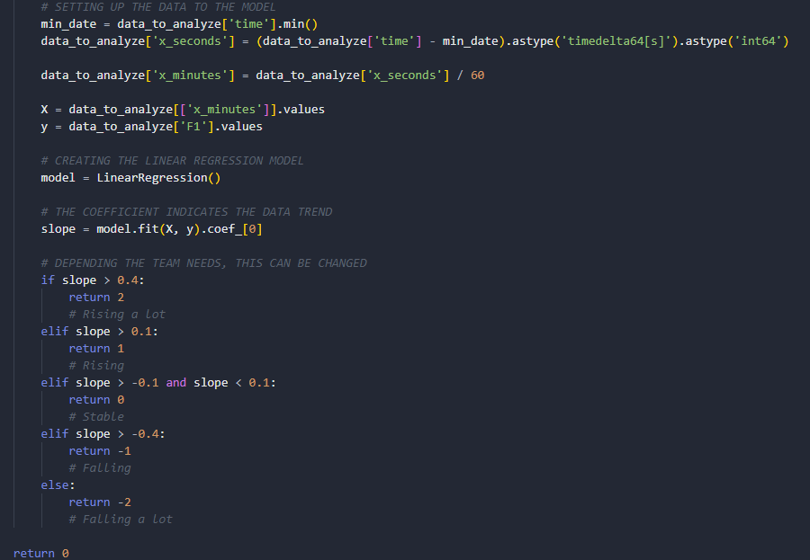
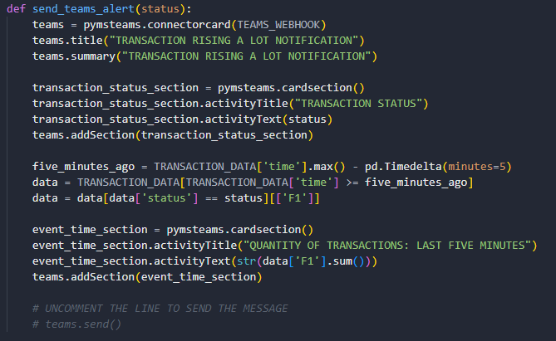
TEST 2: CREATING THE SYSTEM
01.
TRENDS ALERTS IN TEAMS

Slide 15
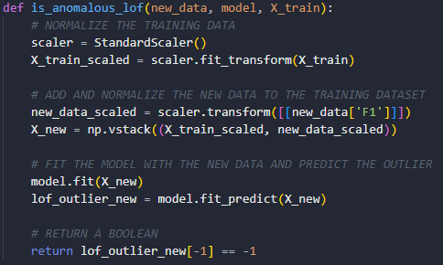
TEST 2: CREATING THE SYSTEM
01.
DETECT ANOMALIES

Slide 16
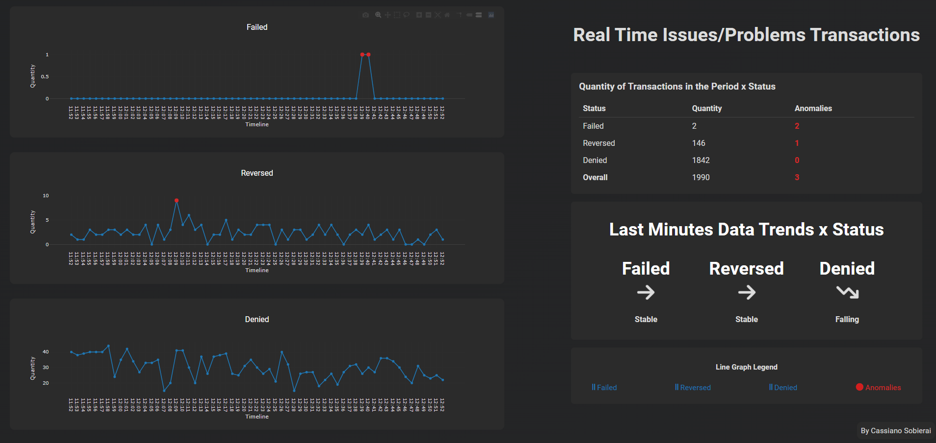
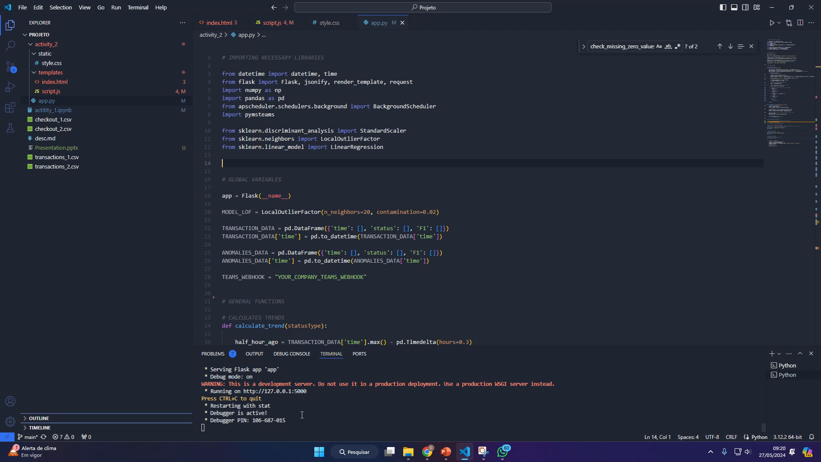
TEST 2: VISUALIZING THE SYSTEM
65%
35%
€1,500/year
Gender
AVERAGE SPEND
+60
mercury
+50
jupiter
+40
venus
AGE
PROFESSION

Slide 17
CONCLUSION
LESSONS LEARNED
1. Need more practice with Local Outlier Factor
2. Linear Regression was useful for understanding trends
3. Communication is essencial when data is limited
4. Chat GPT improves our front-end skills
5. Need to explore more data analysis libraries.

Slide 18
THANK YOU
ANY QUESTIONS?

